Slide 1
Anticipating under all circumstances
a story of neuroscience and mathematics
Isabelle Hoxha – MSNE Project week 2021

Slide 2


Slide 3
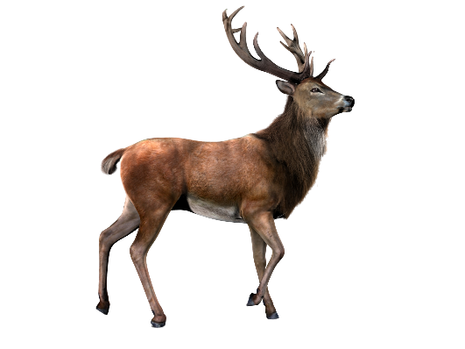

Slide 4
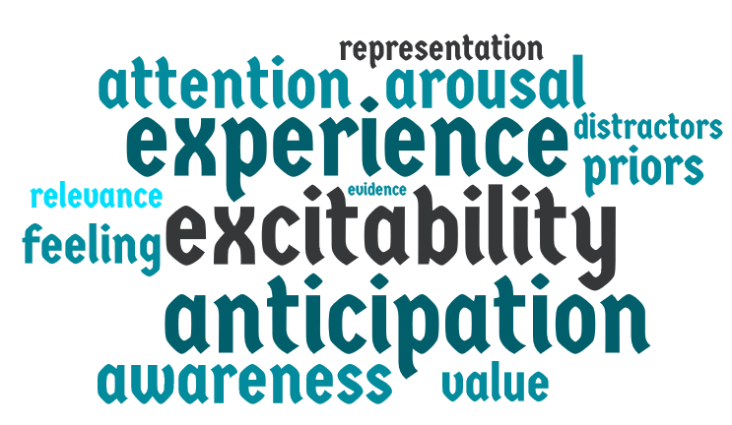
Decision making is…

Slide 5
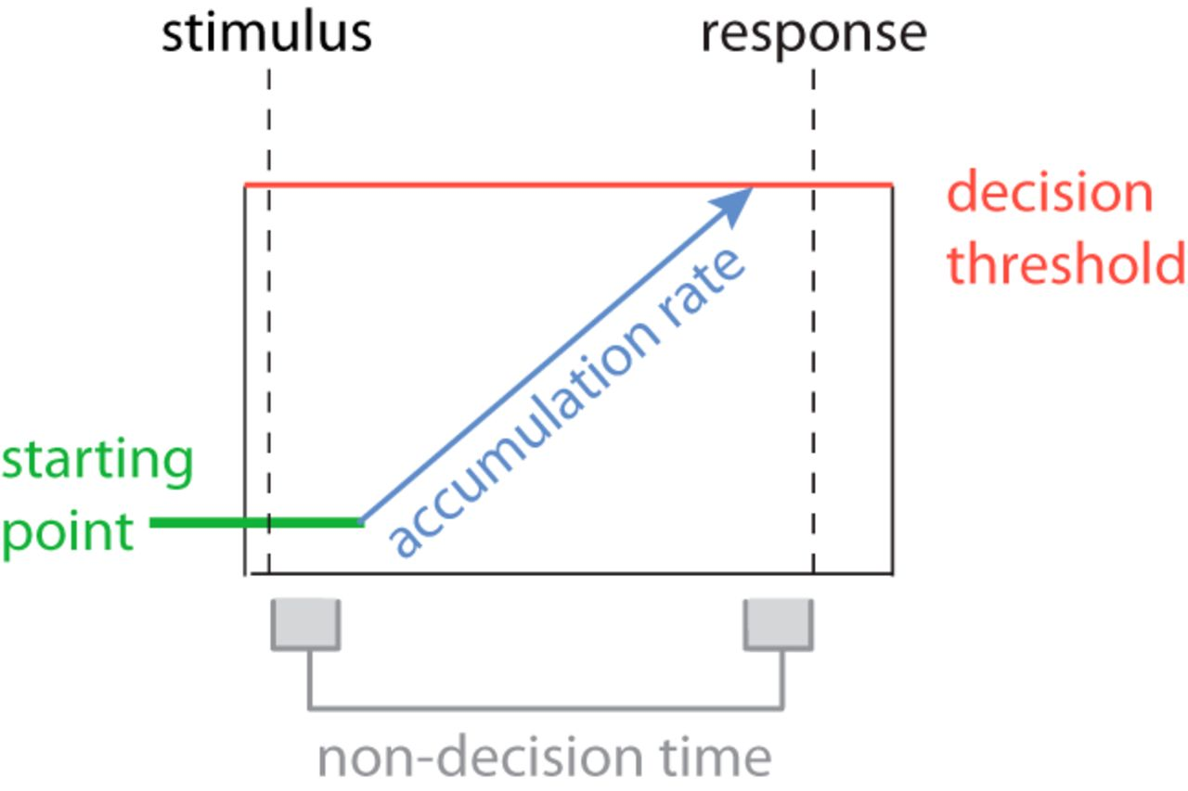
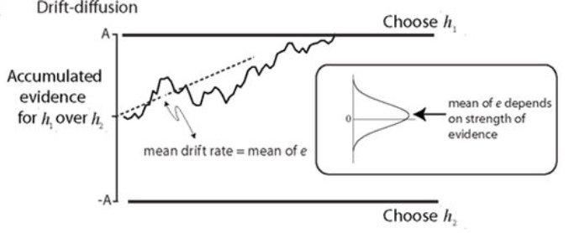
How we conceive decision-making
Evidence-Accumulation models: the DDM
Gold and Shadlen (2007)
Mulder (2014)
$$dx= νdt+σdW$$

Slide 6
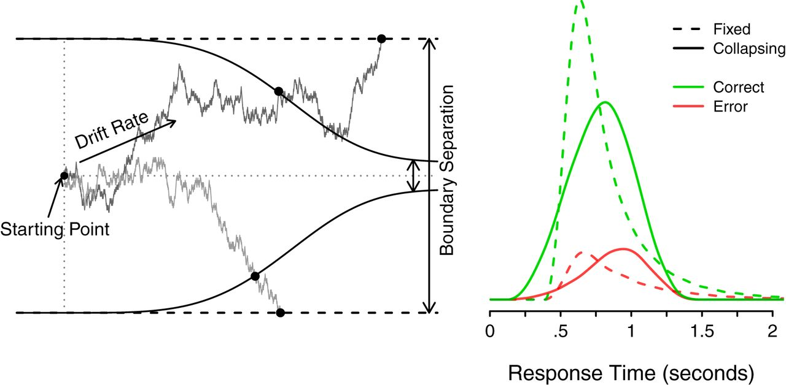
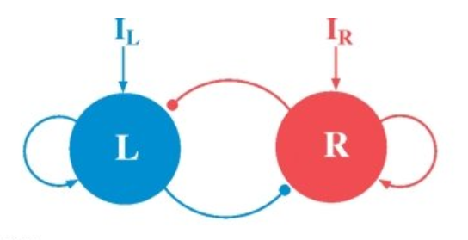
How we conceive decision-making
Variants of the DDM…
… and other models
Cisek et al. 2009, Drugowitsch et al. 2012, Hawkins et al. 2015
Wong and Wang (2006)

Slide 7
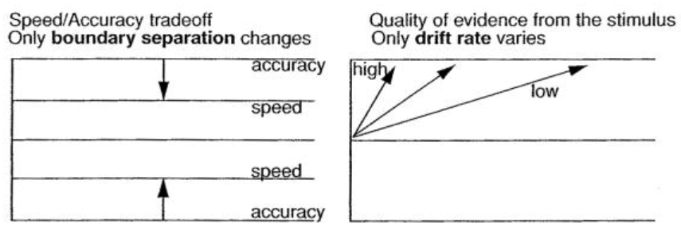
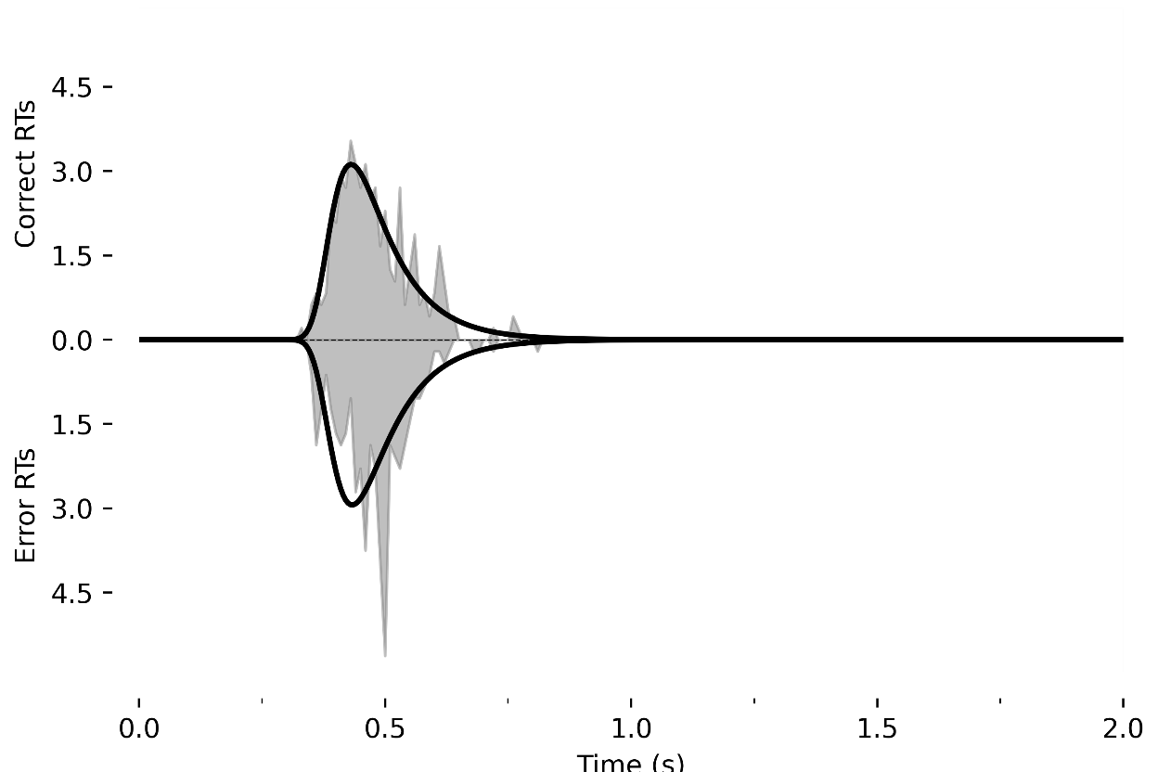
Behavior
Ratcliff and Mc.Koon (2008)
Hoxha et al. 2021 (preprint)

Slide 8
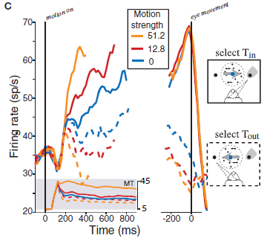
Neurophysiology
Linear integration
Two boundaries
Different rates that depend on motion strength (confidence)
Gold and Shadlen 2007

Slide 9
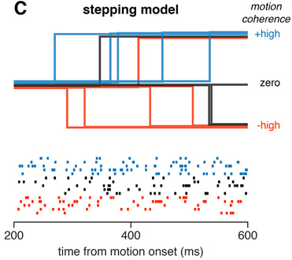
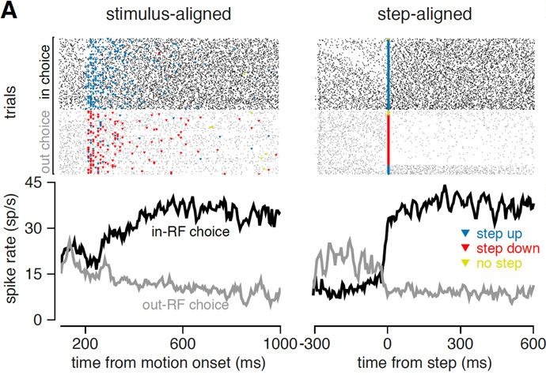
Limitations
2-alternative forced-choice paradigms
Reward structure (wrong/correct)
World is not impacted by the decision
Environment static
Study decisions at the global scale
Latimer et al. 2015

Slide 10
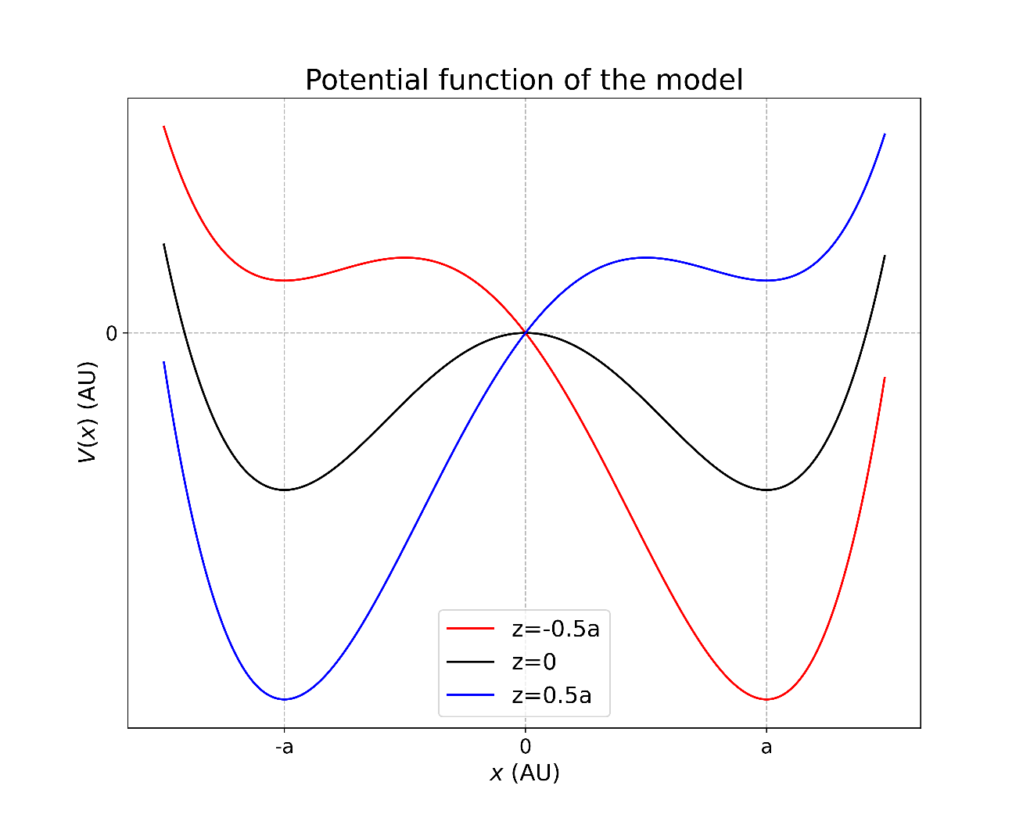
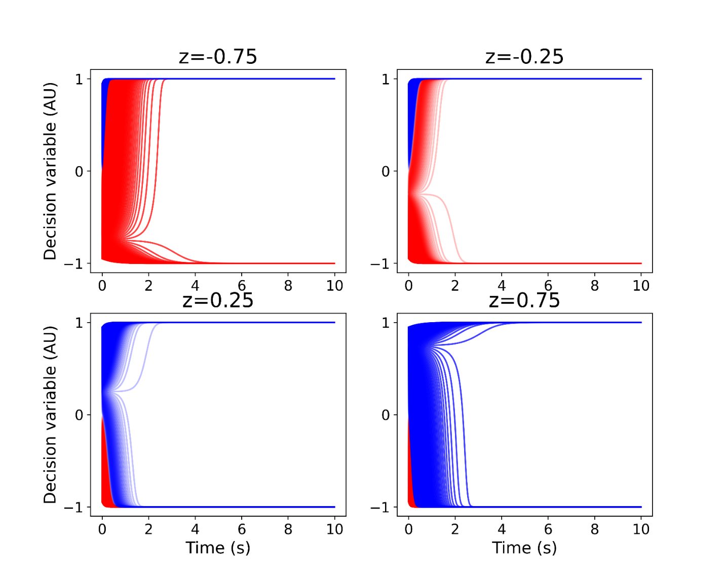
A non-linear model
$$dx=−k\left(x−z\left(t\right)\right)\left(x−a\right)\left(x+a\right)dt+N(t)$$
Hoxha et al., 2021 (preprint)

Slide 11
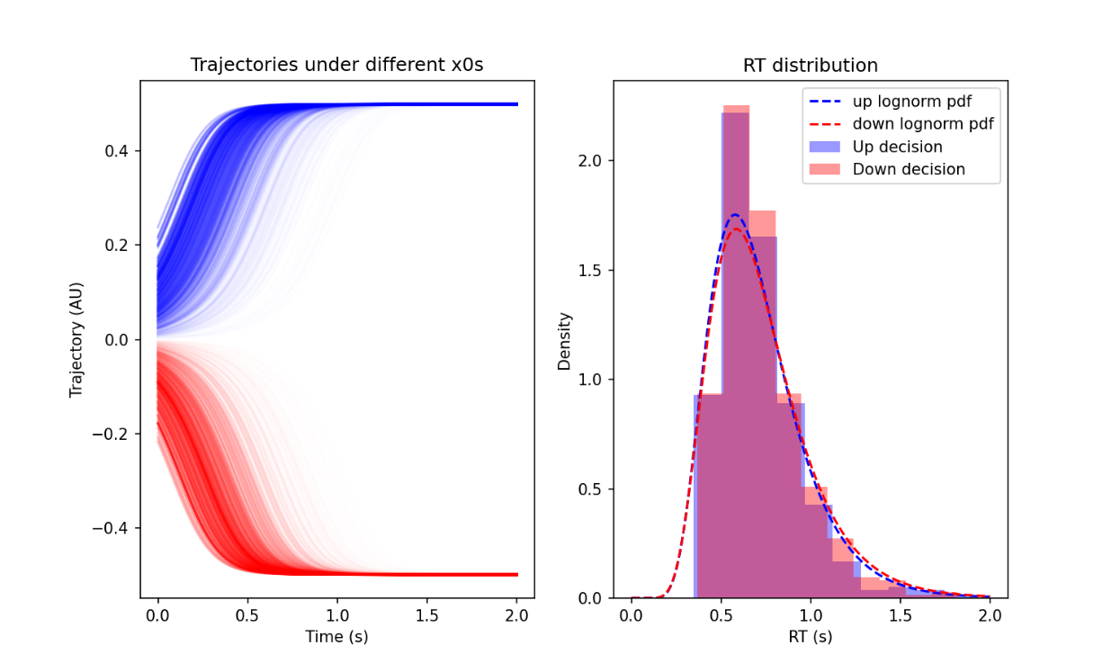

A non-linear model
Hoxha et al., 2021 (preprint)

Slide 12

Anticipation
Live experiment time!

Slide 13
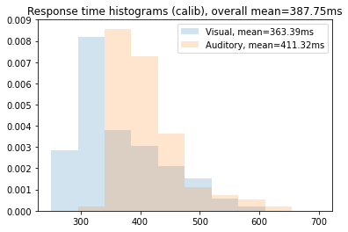
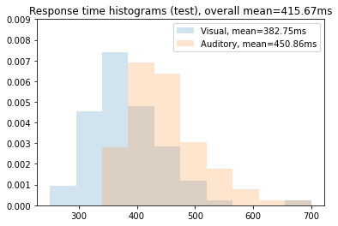
Anticipation
It does have behavioral effects
With a cue: more anticipation: faster response
Without a cue: less anticipation: slower response

Slide 14



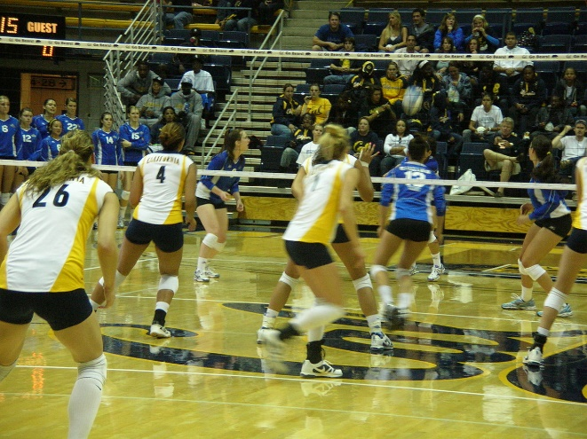

Anticipating is easy…and hard
Done all the time…unconsciously
In neuroscience…:
What is expected?
What brain areas are involved?
When does it start?
Is it done all the time?

Slide 15
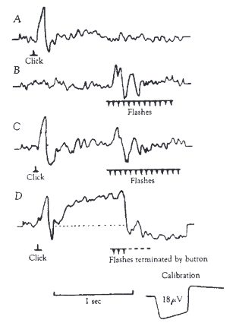
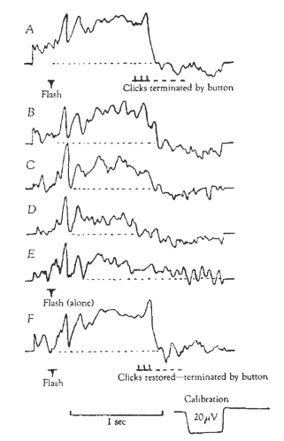
Anticipation in the brain
Contingent Negative Variation
Association between cue and imperative stimulus
Increases as the association becomes stronger
Walter et al. 1964

Slide 16
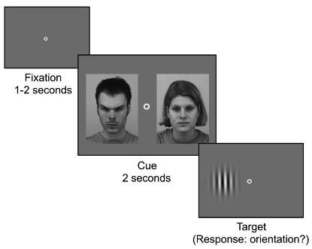
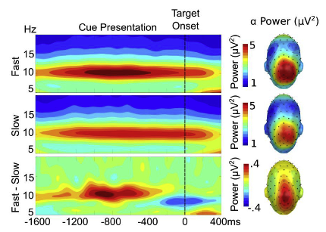
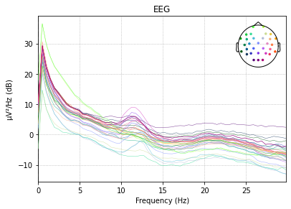
Anticipation in the brain
Alpha pre-activation
Related to levels of attention
Impacts response times
Petro et al. 2019

Slide 17
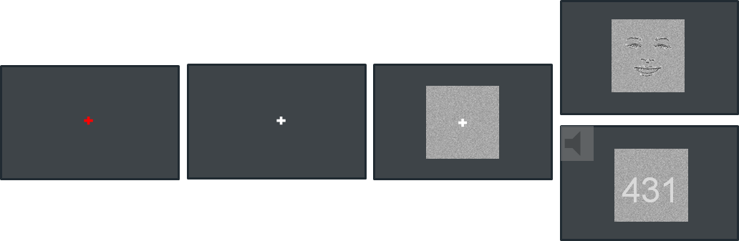

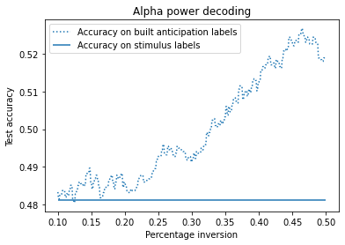
Decoding anticipation
Can we tell what the participant expected given the alpha power in prestimulus period?
9 participants
32 electrodes
480 trials
Select 10 features
Train on half of data (shorter RTs), test on other half
Labels: stimulus labels, for longer response times: invert the label => built anticipation labels

Slide 18
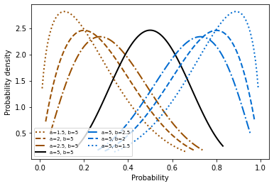
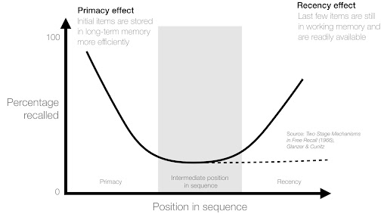
On the importance of history
Global statistics
Link with working memory

Slide 19
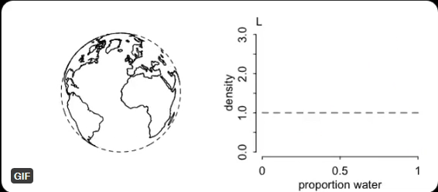
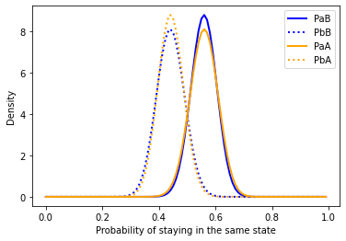
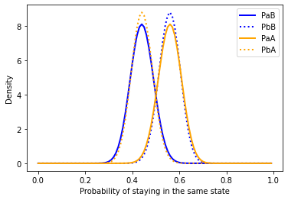
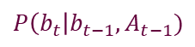
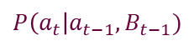
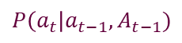
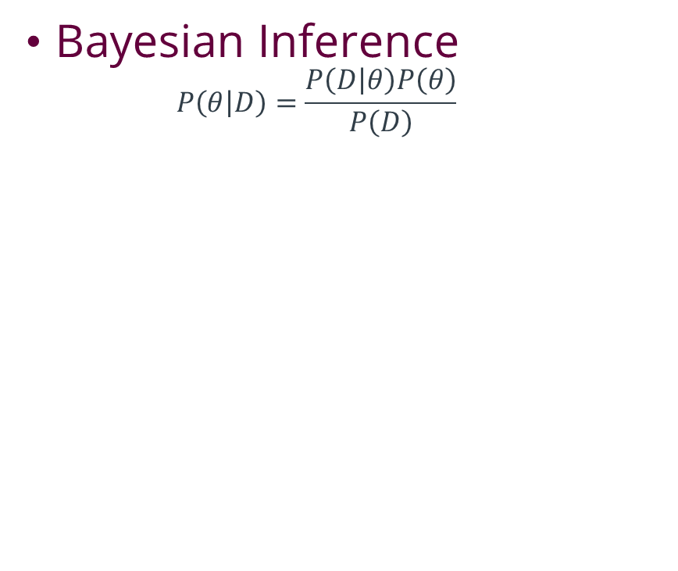
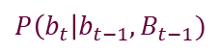
Sequential decisions
Bayesian Inference
$$P\left(θ | D\right)=\frac{P\left(D | θ\right)P\left(θ\right)}{P\left(D\right)}$$
Courtesy of Prof. Dr. Richard McElreath
Anticip. a
Anticip. b
$$P\left(a_{t}\right|a_{t−1},A_{t−1})$$
$$P\left(b_{t}\right|b_{t−1},A_{t−1})$$
$$P\left(a_{t}\right|a_{t−1},B_{t−1})$$
$$P\left(b_{t}\right|b_{t−1},B_{t−1})$$

Slide 20
For more about Bayesian statistics
McElreath, R. (2016). Statistical rethinking: a Bayesian course with examples in R and Stan. Boca Raton: CRC Press/Taylor & Francis Group.
https://xcelab.net/rm/sr2/
Password: symplectic

Slide 21
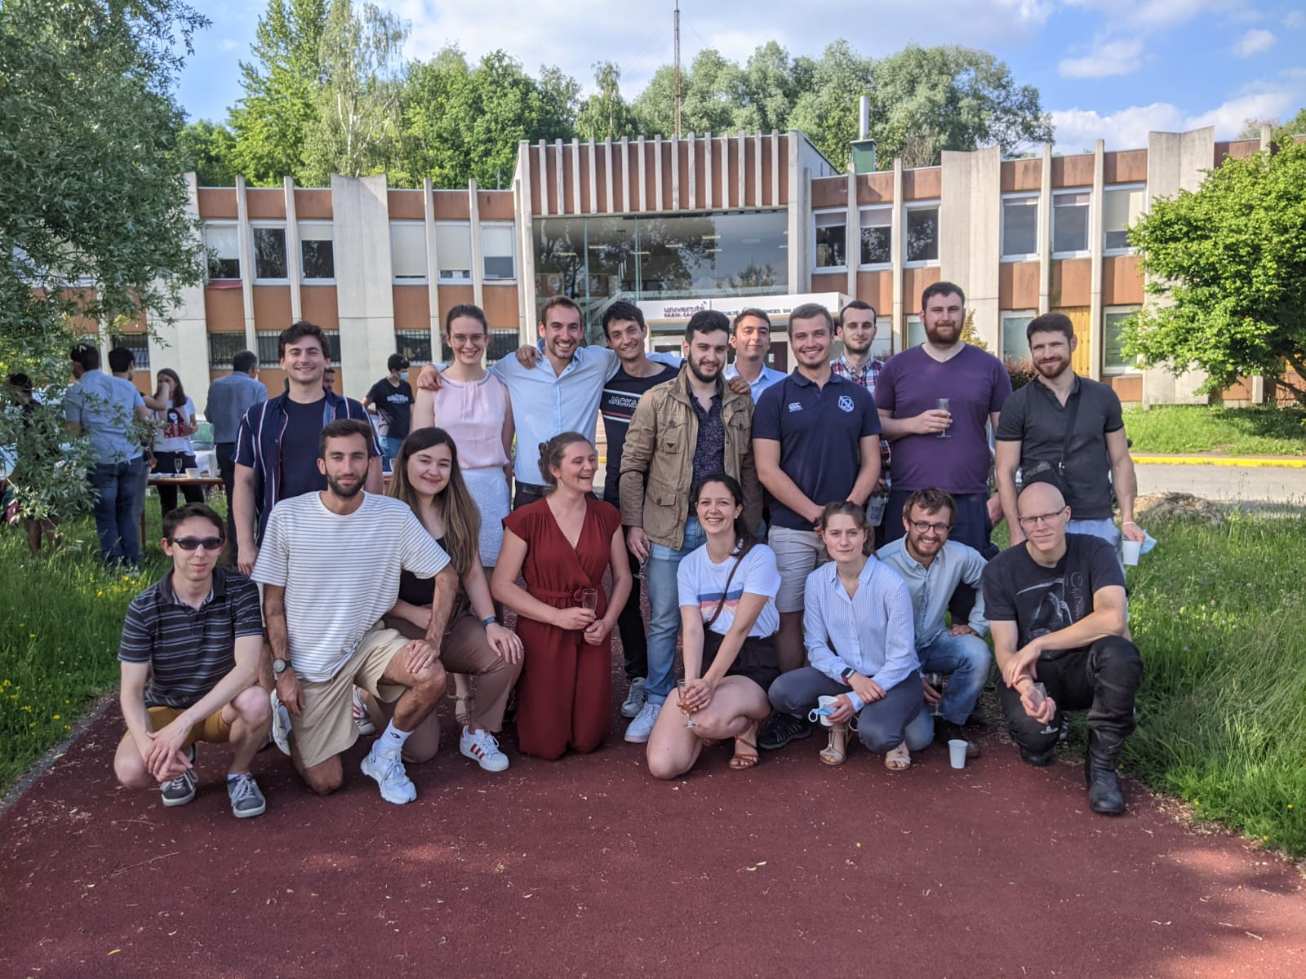



Join us!
@HoxhaIsabelle
isabelle.hoxha@universite-paris-saclay.fr
https://github.com/IsabHox
Cisek, P., Puskas, G. A., and El-Murr, S. (2009). Decisions in Changing Conditions: The Urgency-Gating Model. Journal of Neuroscience 29, 11560–11571.
Drugowitsch, J., Moreno-Bote, R., Churchland, A. K., Shadlen, M. N., and Pouget, A. (2012). The Cost of Accumulating Evidence in Perceptual Decision Making. Journal of Neuroscience 32, 3612–3628.
Gold, J. I., and Shadlen, M. N. (2007). The Neural Basis of Decision Making. Annu. Rev. Neurosci. 30, 535–574.
Hawkins, G. E., Forstmann, B. U., Wagenmakers, E.-J., Ratcliff, R., and Brown, S. D. (2015). Revisiting the Evidence for Collapsing Boundaries and Urgency Signals in Perceptual Decision-Making. Journal of Neuroscience 35, 2476–2484
Latimer, K. W., Yates, J. L., Meister, M. L. R., Huk, A. C., and Pillow, J. W. (2015). Single-trial spike trains in parietal cortex reveal discrete steps during decision-making. Science 349, 184–187. Petro, N. M., Thigpen, N. N., Garcia, S., Boylan, M. R., and Keil, A. (2019). Pre-target alpha power predicts the speed of cued target discrimination. NeuroImage 189, 878–885.
Ratcliff, R., and McKoon, G. (2008). The Diffusion Decision Model: Theory and Data for Two-Choice Decision Tasks. Neural Computation 20, 873–922.
Shadlen, M. N., and Roskies, A. L. (2012). The Neurobiology of Decision-Making and Responsibility: Reconciling Mechanism and Mindedness. Front. Neurosci. 6.
Walter, W. G., Cooper, R., Aldridge, V. J., McCALLUM, W. C., and Winter, A. L. (1964). Contingent Negative Variation : An Electric Sign of Sensori-Motor Association and Expectancy in the Human Brain. Nature 203, 380–384.
Wong, K.-F. (2007). Neural circuit dynamics underlying accumulation of time-varying evidence during perceptual decision making. Front. Comput. Neurosci. 1.

Slide 22
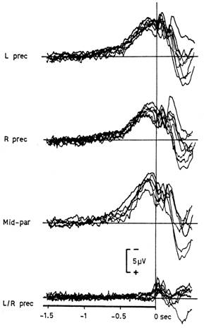
A brief detour in motor execution
Bereitschaftspotential

Slide 23
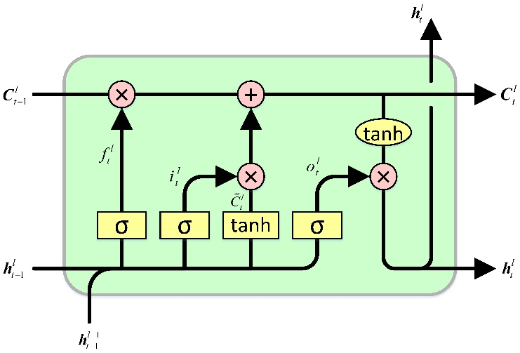
Sequential decisions
LSTM

